Slide 1
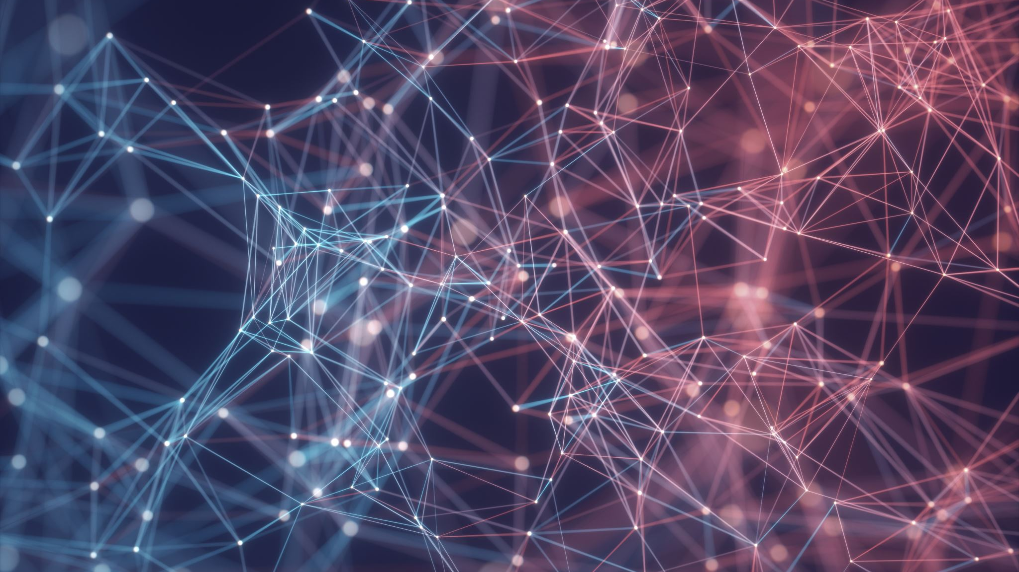
Week 13: Compliance / The Future of Cybersecurity
CIS 303 – Prof. C. R. Johnson

Slide 2
Heralds of change
We have identified several loci of change in the current landscape of cybersecurity –
Privacy as an explicit right
Unprecedented advancements in analytics and learning
Integration of systems – even those nor traditionally integrated
Rise in need for cybersecurity professionals
Shift from supporting to supplementing technologies

Slide 3
But what of the future?
Advancements in AI/machine learning/data analytics has and will reshape the way security tools operate.
Existing cybersecurity professionals will need to learn, new ones will need to know this. 3.5 million unfilled cybersecurity positions in 2021 (est.)
Better is still not bulletproof
Professionals need to get better at people, interpreting data, and risk management.

Slide 4
But what of the future?
While data breaches continue to be an unfortunate and regular occurrence, we are poised to begin experiencing more severe compromises. Greater consequence, greater depth, greater scope.
Cyberwarfare rages on all day every day – a hidden war against unseen threats. It is only a matter of time before this comes to a head.
State actors working through back channels to invest is new devices/apps to gain footholds into millions of individual’s daily lives.

Slide 5
But what of the future?
New devices, new markets, and new threats. Privacy is invaded by vulnerable devices or by the device features themselves.
State actors hoard zero-day vulnerabilities being discovered by unfriendly or unscrupulous actors.
Refinement of organized crime with cyber components.

Slide 6
Cybersecurity trends - 2022
Remote work is permanent.
Remote work security, but also leading a security team effectively remotely.
Zero-trust security
Remote response

Slide 7
Cyber crime-as-a-service (CaaS)
The cyber crime-as-a-service economy puts the accumulated knowledge and tools of thousands, if not millions, of hackers and cyber criminals at the fingertips of an individual attacker. This makes it easy for inexperienced hackers to rapidly stage complex attacks. CaaS marketplaces continue to operate despite several major takedowns by law enforcement agencies as malicious actors adapt their tactics and techniques to stay under the radar.

Slide 8
Malware automation
Malware attacks are increasingly automated, continuing a recent trend that has forced the cyber security industry to catch up. Security experts are no longer dealing with lone hackers testing their skills with hard-to-execute attacks. Now, hackers can use a machine to automate cyber crime activities, letting them execute thousands of attacks a day. Ransomware is becoming so common that only the largest attacks seem to garner any media attention.

Slide 9
Polymorphic malware
A greater number of malware variants now contain polymorphic characteristics, which means they constantly change their identifiable features to better hide from security teams and common detection techniques. Many CaaS offerings contain some element of code that can mutate so it can remain hidden

Slide 10
Third-party risks and threats
As companies continue to ramp up their efforts and adopt digital technologies, many turn to third parties, outsourcing some IT and security support needs. As we’ve discussed before, reliance on third parties increases cyber security risks, especially for companies that do not have a strategy in place for managing these risks.

Slide 11
The human element
Not a new threat, but not going anywhere either.
In five years, internet communications will likely become more secure — especially with the potential rise of quantum networks which will make network-based threats less relevant.
One ongoing challenge is that of human error. Intentionally or not, employees will still enable data loss and attackers will still rely on social engineering tricks such as phishing and business email compromise.

Slide 12
The changing shape of financial fraud
Payment modernization means that financial transactions may become almost entirely digital, requiring support from various platforms and methods.
These platforms will likely be less centralized, and regulations will take time to catch up. This will expand the threat surface for financial institutions and tools, resulting in more fraud-oriented security solutions focused on digital currencies, the blockchain, and real-time payment security.

Slide 13
Changing Technologies
More cloud
Less passwords
More advanced detection – but greater cybersecurity skills-gaps
Incident Response
Supply-Chain Security
Risk Analysis / Threat Intel
Security Architects / Engineers

